Slide 1
CS 61C: Great Ideas in Computer Architecture (Machine Structures) Caches Part 3
Instructors:
Krste Asanovic & Vladimir Stojanovic
http://inst.eecs.berkeley.edu/~cs61c/

Slide 2


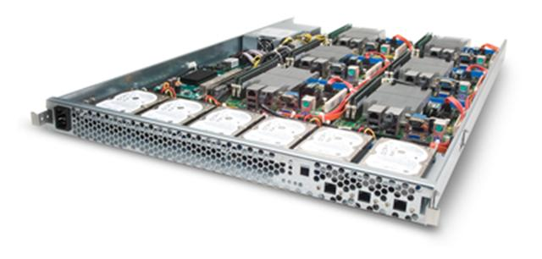
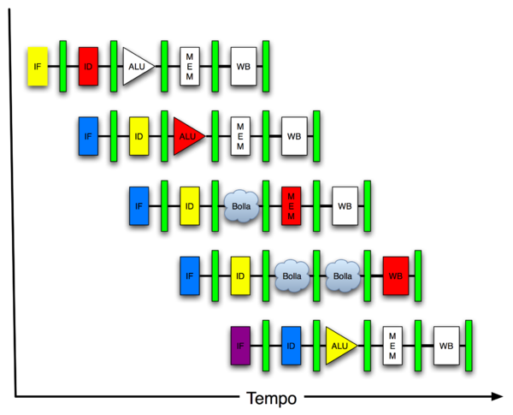
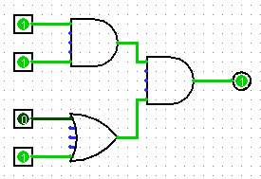
You Are Here!
Software Hardware
Parallel Requests
Assigned to computer
e.g., Search “Katz”
Parallel Threads
Assigned to core
e.g., Lookup, Ads
Parallel Instructions
>1 instruction @ one time
e.g., 5 pipelined instructions
Parallel Data
>1 data item @ one time
e.g., Add of 4 pairs of words
Hardware descriptions
All gates @ one time
Programming Languages
Warehouse Scale Computer
Smart Phone
Harness Parallelism &
Achieve High Performance
Computer
Today’s
Lecture
Core
…
Core
Memory (Cache)
Input/Output
Core
Instruction Unit(s)
Functional
Unit(s)
A₀+B₀
A₁+B₁
A₂+B₂
A₃+B₃
Main Memory
Logic Gates

Slide 3
Caches Review
Direct-Mapped vs. Set-Associative vs. Fully Associative
AMAT = Hit Time + Miss Rate * Miss Penalty
3 Cs of cache misses: Compulsory, Capacity, Conflict
Effect of cache parameters on performance

Slide 4
Primary Cache Parameters
Block size (aka line size)
how many bytes of data in each cache entry?
Associativity
how many ways in each set?
Direct-mapped => Associativity = 1
Set-associative => 1 < Associativity < #Entries
Fully associative => Associativity = #Entries
Capacity (bytes) = Total #Entries * Block size
#Entries = #Sets * Associativity

Slide 5
Other Cache Parameters
Write Policy
Replacement policy

Slide 6
Write Policy Choices
Cache hit:
write through: writes both cache & memory on every access
Generally higher memory traffic but simpler pipeline & cache design
write back: writes cache only, memory `written only when dirty entry evicted
A dirty bit per line reduces write-back traffic
Must handle 0, 1, or 2 accesses to memory for each load/store
Cache miss:
no write allocate: only write to main memory
write allocate (aka fetch on write): fetch into cache
Common combinations:
write through and no write allocate
write back with write allocate

Slide 7
Replacement Policy
In an associative cache, which line from a set should be evicted when the set becomes full?
Random
Least-Recently Used (LRU)
LRU cache state must be updated on every access
True implementation only feasible for small sets (2-way)
Pseudo-LRU binary tree often used for 4-8 way
First-In, First-Out (FIFO) a.k.a. Round-Robin
Used in highly associative caches
Not-Most-Recently Used (NMRU)
FIFO with exception for most-recently used line or lines
This is a second-order effect. Why?
Replacement only happens on misses
Notes:
NLRU used in Alpha TLBs (jse)

Slide 8
Sources of Cache Misses (3 C’s)
Compulsory (cold start, first reference):
1st access to a block, “cold” fact of life, not a lot you can do about it.
If running billions of instructions, compulsory misses are insignificant
Capacity:
Cache cannot contain all blocks accessed by the program
Misses that would not occur with infinite cache
Conflict (collision):
Multiple memory locations mapped to same cache set
Misses that would not occur with ideal fully associative cache
Notes:
(Capacity miss) That is the cache misses are due to the fact that the cache is simply not large enough to contain all the blocks that are accessed by the program.
The solution to reduce the Capacity miss rate is simple: increase the cache size.
Here is a summary of other types of cache miss we talked about.
First is the Compulsory misses. These are the misses that we cannot avoid. They are caused when we first start the program.
Then we talked about the conflict misses. They are the misses that caused by multiple memory locations being mapped to the same cache location.
There are two solutions to reduce conflict misses. The first one is, once again, increase the cache size. The second one is to increase the associativity.
For example, say using a 2-way set associative cache instead of directed mapped cache.
But keep in mind that cache miss rate is only one part of the equation. You also have to worry about cache access time and miss penalty. Do NOT optimize miss rate alone.
Finally, there is another source of cache miss we will not cover today. Those are referred to as invalidation misses caused by another process, such as IO , update the main memory so you have to flush the cache to avoid inconsistency between memory and cache.
+2 = 43 min. (Y:23)

Slide 9
Impact of Cache Parameters on Performance
AMAT = Hit Time + Miss Rate * Miss Penalty
Note, we assume always first search cache, so must charge hit time for both hits and misses!
For misses, characterize by 3Cs

Slide 10
CPU-Cache Interaction (5-stage pipeline)
0x4
Add
E
Decode,
Register
Fetch
M
A
we
Y
addr
bubble
ALU
Y
IR
B
Primary
Data
Cache
rdata
PC
addr
inst
D
R
hit?
wdata
hit?
wdata
PCen
Primary
Instruction
Cache
MD1
MD2
Stall entire CPU on data cache miss
To Memory Control
Cache Refill Data from Lower Levels of Memory Hierarchy
Notes:
How are writes to istream handled?

Slide 11
Increasing Block Size?
Hit time as block size increases?
Hit time unchanged, but might be slight hit-time reduction as number of tags is reduced, so faster to access memory holding tags
Miss rate as block size increases?
Goes down at first due to spatial locality, then increases due to increased conflict misses due to fewer blocks in cache
Miss penalty as block size increases?
Rises with longer block size, but with fixed constant initial latency that is amortized over whole block

Slide 12
Increasing Associativity?
Hit time as associativity increases?
Increases, with large step from direct-mapped to >=2 ways, as now need to mux correct way to processor
Smaller increases in hit time for further increases in associativity
Miss rate as associativity increases?
Goes down due to reduced conflict misses, but most gain is from 1->2->4-way with limited benefit from higher associativities
Miss penalty as associativity increases?
Unchanged, replacement policy runs in parallel with fetching missing line from memory

Slide 13
Increasing #Entries?
Hit time as #entries increases?
Increases, since reading tags and data from larger memory structures
Miss rate as #entries increases?
Goes down due to reduced capacity and conflict misses
Architects rule of thumb: miss rate drops ~2x for every ~4x increase in capacity (only a gross approximation)
Miss penalty as #entries increases?
Unchanged

Slide 14
Administrivia
Project 2, Part 2 due 3/22
No assigned work over spring break
Next assignment, HW5, due 04/05
Midterm II is 04/09
Conflict? Email Sagar
DSP will receive email about accommodations soon

Slide 15
How to Reduce Miss Penalty?
Could there be locality on misses from a cache?
Use multiple cache levels!
With Moore’s Law, more room on die for bigger L1 caches and for second-level (L2) cache
And in some cases even an L3 cache!
IBM mainframes have ~1GB L4 cache off-chip.

Slide 16
Review: Memory Hierarchy
Processor
Inner
Increasing distance from processor, decreasing speed
Levels in memory hierarchy
Level 1
Level 2
Level 3
Outer
. . .
Level n
Size of memory at each level
As we move to outer levels the latency goes up and price per bit goes down.

Slide 17
From Lecture 11: In the News
At ISSCC 2015 in San Francisco yesterday, latest IBM mainframe chip details
z13 designed in 22nm SOI technology with seventeen metal layers, 4 billion transistors/chip
8 cores/chip, with 2MB L2 cache, 64MB L3 cache, and 480MB L4 off-chip cache.
5GHz clock rate, 6 instructions per cycle, 2 threads/core
Up to 24 processor chips in shared memory node

Slide 18
IBM z13 Memory Hierarchy

Slide 19
Local vs. Global Miss Rates
Local miss rate – the fraction of references to one level of a cache that miss
Local Miss rate L2$ = $L2 Misses / L1$ Misses
Global miss rate – the fraction of references that miss in all levels of a multilevel cache
L2$ local miss rate >> than the global miss rate

Slide 20
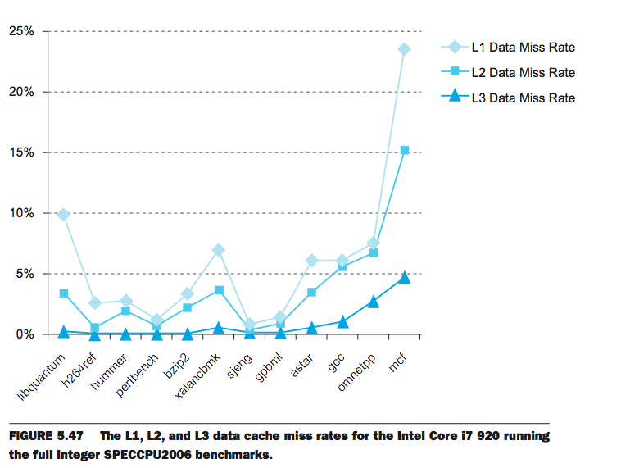
L1 Cache: 32KB I$, 32KB D$
L2 Cache: 256 KB
L3 Cache: 4 MB

Slide 21
Local vs. Global Miss Rates
Local miss rate – the fraction of references to one level of a cache that miss
Local Miss rate L2$ = $L2 Misses / L1$ Misses
Global miss rate – the fraction of references that miss in all levels of a multilevel cache
L2$ local miss rate >> than the global miss rate
Global Miss rate = L2$ Misses / Total Accesses
= L2$ Misses / L1$ Misses x L1$ Misses / Total Accesses
= Local Miss rate L2$ x Local Miss rate L1$
AMAT = Time for a hit + Miss rate x Miss penalty
AMAT = Time for a L1$ hit + (local) Miss rate L1$ x (Time for a L2$ hit + (local) Miss rate L2$ x L2$ Miss penalty)

Slide 22
Clickers/Peer Instruction
Overall, what are L2 and L3 local miss rates?
A: L2 > 50%, L3 > 50%
B: L2 ~ 50%, L3 < 50%
C: L2 ~ 50%, L3 ~ 50%
D: L2 < 50%, L3 < 50%
E: L2 > 50%, L3 ~50%

Slide 23
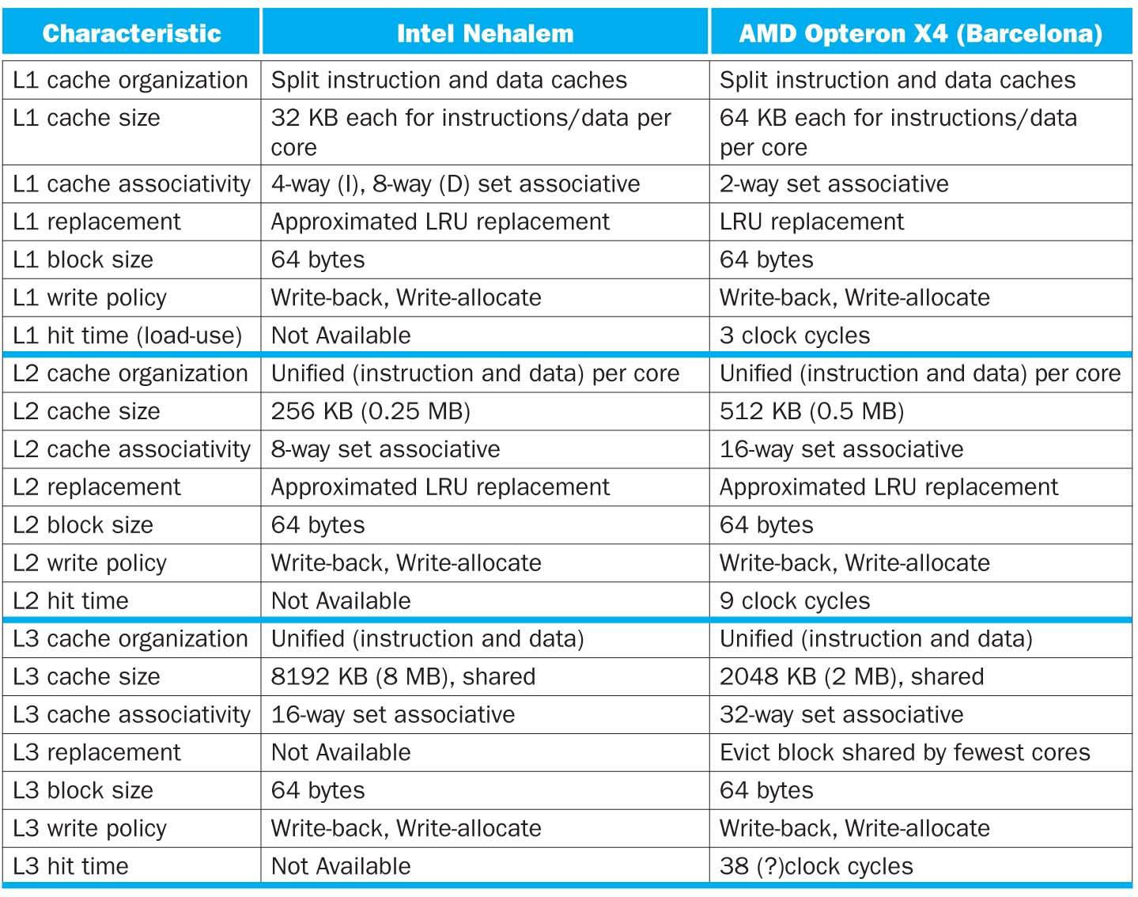

Slide 24
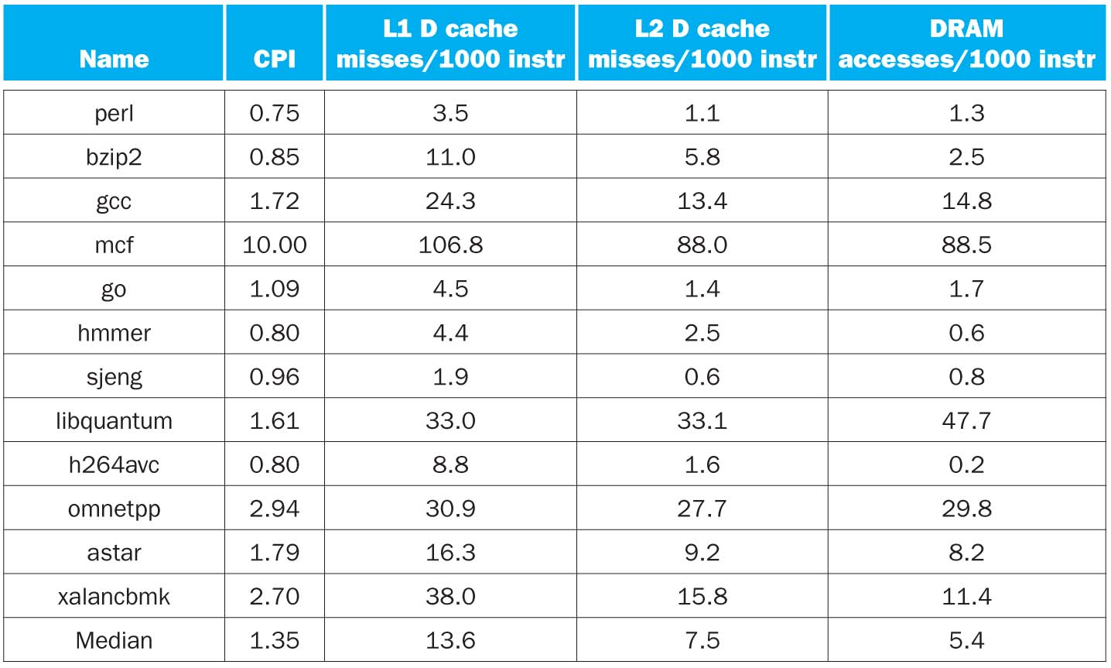
CPI/Miss Rates/DRAM Access SpecInt2006
Data Only
Data Only
Instructions and Data

Slide 25
In Conclusion, Cache Design Space
Several interacting dimensions
Cache size
Block size
Associativity
Replacement policy
Write-through vs. write-back
Write-allocation
Optimal choice is a compromise
Depends on access characteristics
Workload
Use (I-cache, D-cache)
Depends on technology / cost
Simplicity often wins
Cache Size
Associativity
Block Size
Bad
Good
Factor A
Factor B
Less
More

